Slide 1

6th Grade Accelerated Math
Unit 7, Lesson 3 Decomposing Quadrilaterals to Find Area Volume 1, pg. 308

Slide 2


Benchmark
MA.6.GR.2.2
Solve mathematical and real-world problems involving the area of quadrilaterals and composite figures by decomposing them into triangles or rectangles.
volume 1, pg. 308

Slide 3
Integrated Mathematical Thinking and Reasoning Standards
MA.K12.MTR.1.1 Actively participate in effortful learning both individually and collectively.
MA.K12.MTR.2.1 Demonstrate understanding by representing problems in multiple ways.
MA.K12.MTR.4.1 Engage in discussions that reflect on the mathematical thinking of self and others.
MA.K12.MTR.5.1 Use patterns and structure to help understand and connect mathematical concepts.
volume 1, pg. 308

Slide 4

Learning Target
I can find the area of quadrilaterals by decomposing them into triangles and rectangles.
volume 1, pg. 308

Slide 5

Warm-Up
volume 1, pg. 308

Slide 6
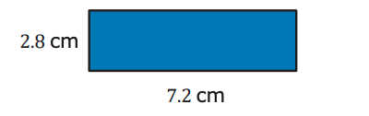
7.3.1 Warm-Up: Perimeter and Area of a Rectangle
A rectangle is shown with side lengths given in centimeters (cm).
Find the perimeter of the rectangle. Include units.
Perimeter = _________
b. Find the area of the rectangle. Include units.
Area = __________
volume 1, pg. 308

Slide 7

Collaboration
volume 1, pg. 309

Slide 8

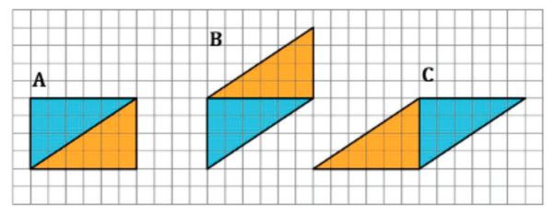
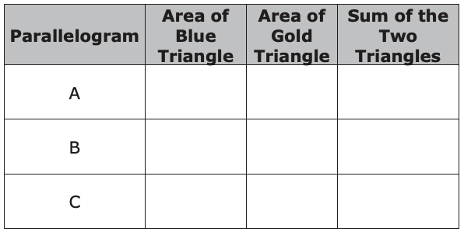
7.3.2 Collaboration: Decomposing Parallelograms
Three parallelograms are shown on the grid. Each square is 1 centimeter (cm) by 1 cm.
1. Work with your partner to complete the table using the figures shown in the grid. Include units.
volume 1, pg. 309

Slide 9
2. Discuss with your partner how the areas of the triangles are related to the area of the parallelogram they form. Write a brief summary of your discussion.
volume 1, pg. 309

Slide 10

Exploration
volume 1, pg. 309

Slide 11

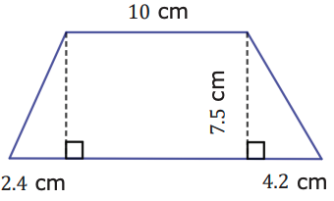

7.3.3 Exploration: Finding Area by Decomposing
A quadrilateral with measurements in centimeters (cm) is shown.
Copy the image on a piece of paper.
volume 1, pg. 309

Slide 12
Decompose the quadrilateral into two triangles and a rectangle by cutting along the dotted lines. Glue or tape the three figures here.
volume 1, pg. 309

Slide 13
c. Using the measurements given in the original image, label the base and height of each figure.
d. What is the area of each figure? Include units.
e. Find the area of the original quadrilateral by finding the sum of the three figures. Include units.
volume 1, pg. 310

Slide 14
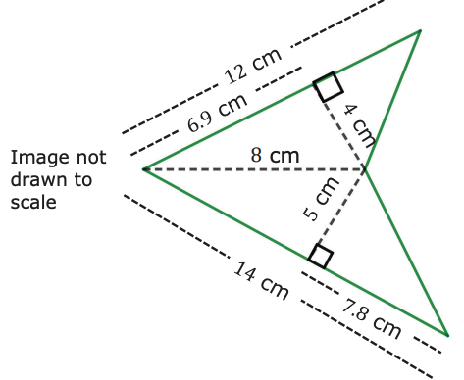
2. Another quadrilateral is shown.
a. Decompose the quadrilateral into triangles. Sketch the decomposed triangles here.
volume 1, pg. 310

Slide 15
b. Using the measurements given in the original image, label the base and height of each triangle.
c. Find the area of the original quadrilateral by finding the sum of the areas of the decomposed triangles. Include units.
volume 1, pg. 310-311

Slide 16
d. Sketch any other ways you could have decomposed the original figure.
e. Explain if decomposing the figure changes the area of the original figure.
volume 1, pg. 311

Slide 17

Guided Practice
volume 1, pg. 311

Slide 18

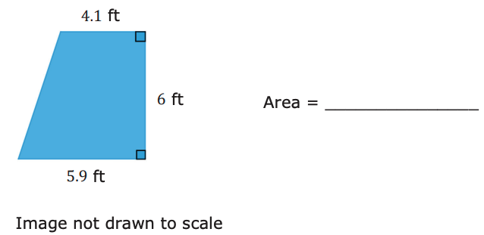
7.3.4 Guided Practice: Finding Area by Decomposing
1. Decompose the quadrilateral to find the area. Lengths are shown in feet (ft). Include units.
volume 1, pg. 311

Slide 19
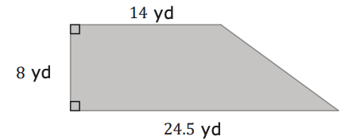
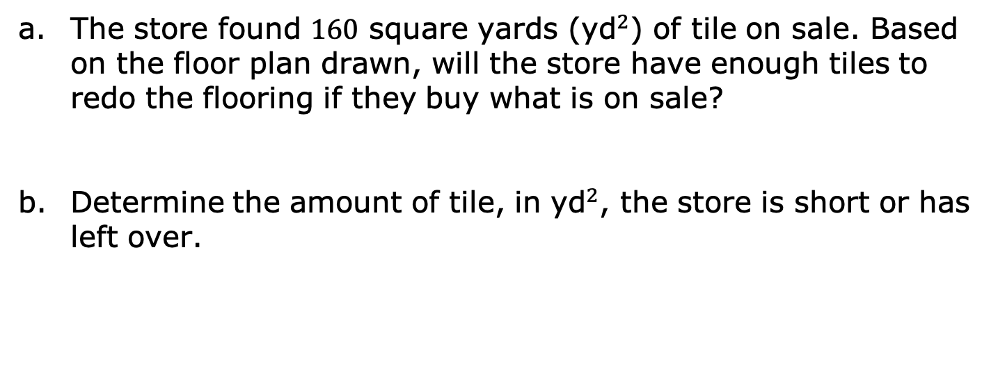
2. The floor plan of a store is shown with measurements in yards (yd).
The store found 160 square yards (${\text{yd}}^{2}$) of tile on sale. Based on the floor plan drawn, will the store have enough tiles to redo the flooring if they buy what is on sale?
Determine the amount of tile, in ${\text{yd}}^{2}$, the store is short or has left over.
volume 1, pg. 312

Slide 20

Your Turn
volume 1, pg. 312

Slide 21
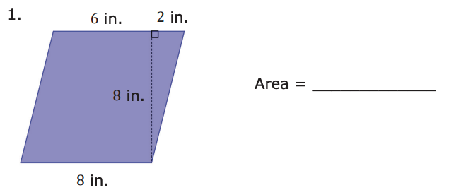
7.3.5 Your Turn!
Find the area of each quadrilateral by decomposing. Lengths are shown in inches (in.). Include units.
volume 1, pg. 312

Slide 22
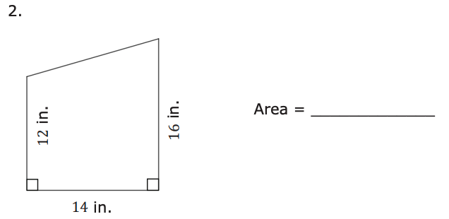
volume 1, pg. 313

Slide 23
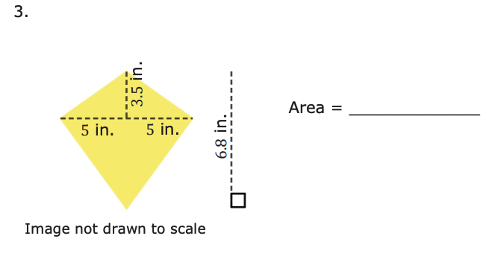
volume 1, pg. 313

Slide 24

Wrap-Up
volume 1, pg. 314

Slide 25
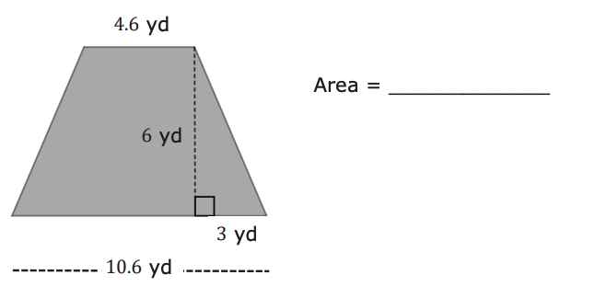
7.3.6 Wrap-Up: Ticket Out the Door
1. Find the area of each quadrilateral by decomposing. Lengths are given in yards (yd). Include units.
volume 1, pg. 314

